Slide 1
Mars Global Mosaic
Mars Global Mosaic: Mapping Lava Flows, Fluvial Channels, and Impact Craters in Visible and Infrared
REMOTE SENSING 2026 OCN 4704 · Logan Edwards
Interim Presentation · status as of 8 October 2026

Slide 2
Project Goals
Assemble one co-registered visible and thermal-infrared mosaic of Mars in ArcGIS Pro, over the ±60° band the THEMIS night mosaic covers (86.6% of the surface), and use it to map lava flows, fluvial channels and impact craters.
One co-registered stack: Viking visible colour, THEMIS day and night infrared, HRSC/MOLA topography, on a single grid over ±60°.
Map and classify the three landform families from it, in a type area first (Ius Chasma) and then across ±60°.
Test whether thermal infrared separates surfaces that visible light cannot.
Score every product against something it never saw: held-out hand labels, the IAU crater gazetteer, and the USGS geologic map.

Slide 3
Relevant Spectral Bands
Band or product | Wavelength | Cell | What it contributes
Viking MDIM 2.1 R, G, B | visible, ~0.4–0.7 µm | 232 m | Albedo: bright dust against dark basalt. Keeps real regional differences (§28.10).
THEMIS Day IR (v12) | thermal IR, 6.8–14.9 µm | 100 m | Daytime temperature: bright in visible = cool by day (r −0.49 at Ius, §18.3).
THEMIS Night IR (v14, ±60°) | thermal IR, 6.8–14.9 µm | 100 m | Night temperature: rock holds heat. The most independent band, |r| ≤ 0.12 (§18.3).
HRSC/MOLA blended DEM | altimetry + stereo | 200 m | Slope in degrees, local relief, hillshade, flow routing, closed-depression depth (§20).
Diurnal contrast index | day − night, relative | 100 m | A local material discriminator inside one area; not thermal inertia, not planet-wide (§24, §28.10).

Slide 4
Why Fuse Them: Three Independent Dimensions
Ius Chasma, r | Viking R | Viking G | Viking B | Day IR | Night IR
Viking R | 1 | +0.960 | +0.925 | −0.486 | −0.121
Viking G | +0.960 | 1 | +0.993 | −0.496 | −0.085
Viking B | +0.925 | +0.993 | 1 | −0.488 | −0.068
Day IR | −0.486 | −0.496 | −0.488 | 1 | +0.105
Night IR | −0.121 | −0.085 | −0.068 | +0.105 | 1
Three visible bands are one dimension (r 0.93–0.99); day IR adds a second, night IR a third. Effective dimensionality ≈ 3: the measured case for fusing them. PROJECT-KNOWLEDGE.md §18.3

Slide 5
Project Tasks and Percent Complete
# | Task | Where it stands | 13 Sep | Now
1 | Scope, targets and type area | Ius Chasma type area; ±60° extent decided | 90% | –
2 | Raster acquisition | Three globals + THEMIS Night IR | 100% | –
3 | Statistics, stretches, pyramids | All products overviewed; the four source globals still not | 70% | –
4 | Grouped mosaic viewer | Done | 100% | –
5 | DEM terrain derivatives | Rebuilt in degrees, type area and ±60°; WARNING 000869 gone | 80% | –
6 | Image-gradient products | Renamed Gradient_*; not used further | 70% | –
7 | Jezero context | Hosted services only; HiRISE link dead | 20% | –
8 | Classification | ±60° SVM on hand-drawn labels: 73.5%, κ 0.58 held out | 20% | –
9 | CRS harmonisation | Done: one 100 m / 200 m grid over ±60° | 15% | –
10 | Visible + IR composite | Done: type area; 7-band ±60° stack | 5% | –
11 | Landform digitising | Classes ready and empty; 512 training polygons drawn | 0% | –
12 | Crater inventory | Robbins catalogue in the project (385,049); 5,144 basins ≥ 20 km at ±60° | 0% | –
13 | Map layouts | 8 layouts, from none | 0% | –
14 | Report and presentations | Interim being rebuilt | 25% | –

Slide 6
Processing Completed Since the Last Report
When | What | Outcome | KB
18 Sep | Type-area stack: four inputs on one 100 m grid | Composite in 8.8 s, 100% co-valid | §18
18 Sep | THEMIS Night IR acquired | 14.14 GB, pixel-aligned with day IR | §15
18 Sep | Slope and hillshade rebuilt on a metric grid | Slope in degrees; z-factor warning gone | §20
19 Sep | ±60° grids and diurnal contrast index | 15.2 bn px in 36.3 min | §28
19 Sep | Channel and crater candidates, Ius | 2,610 channels; 1,685 closed depressions in 49 s | §25–26
19 Sep | Basins at ±60° | 5,144 ≥ 20 km in 48 s | §28.11
24–30 Sep | Global composites in the Pro GUI (desktop) | First successes: 2 h 52 m, 3 h 10 m | §29
29 Sep | Hand-drawn training polygons; SVMs | Four classes; two ±60° maps | §29
2 Oct | The first two SVM maps checked | Tile artefact; mostly elevation | §30
3 Oct | Corrected stack; SVM scored held out | 73.5%, κ 0.58 (5 × 5) | §31–32
6–8 Oct | Backup to GitHub; class codes; layout 08 | Eight layouts | §35–38

Slide 7
Preliminary Results
What the data show so far
Every map is a layout in the ArcGIS project, exported fresh for this deck.

Slide 8
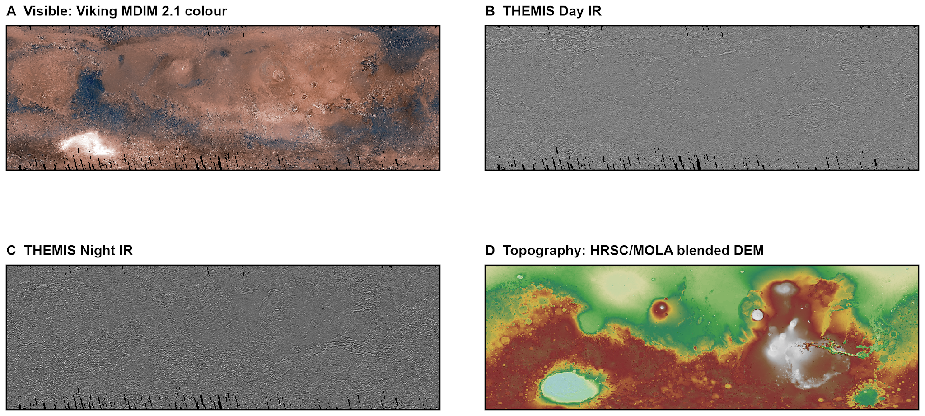
The mosaic at ±60°
Four datasets on one 200 m grid for the first time
The failed global Composite Bands is solved: project first, then bound the extent
Night-IR coverage sets the extent: 86.6% of the planet
PROJECT-KNOWLEDGE.md §16, §18, §28.1, §38

Slide 9
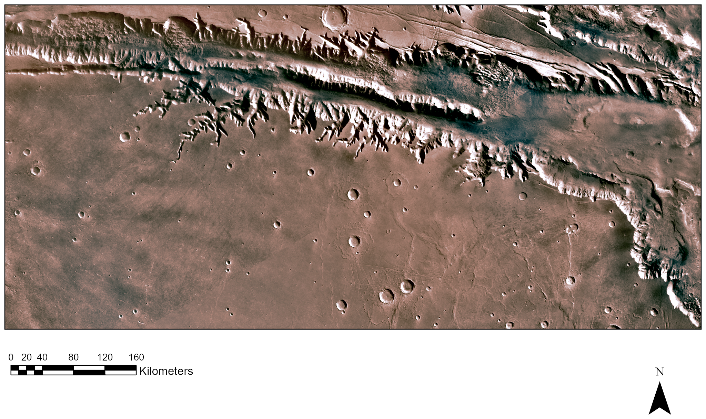
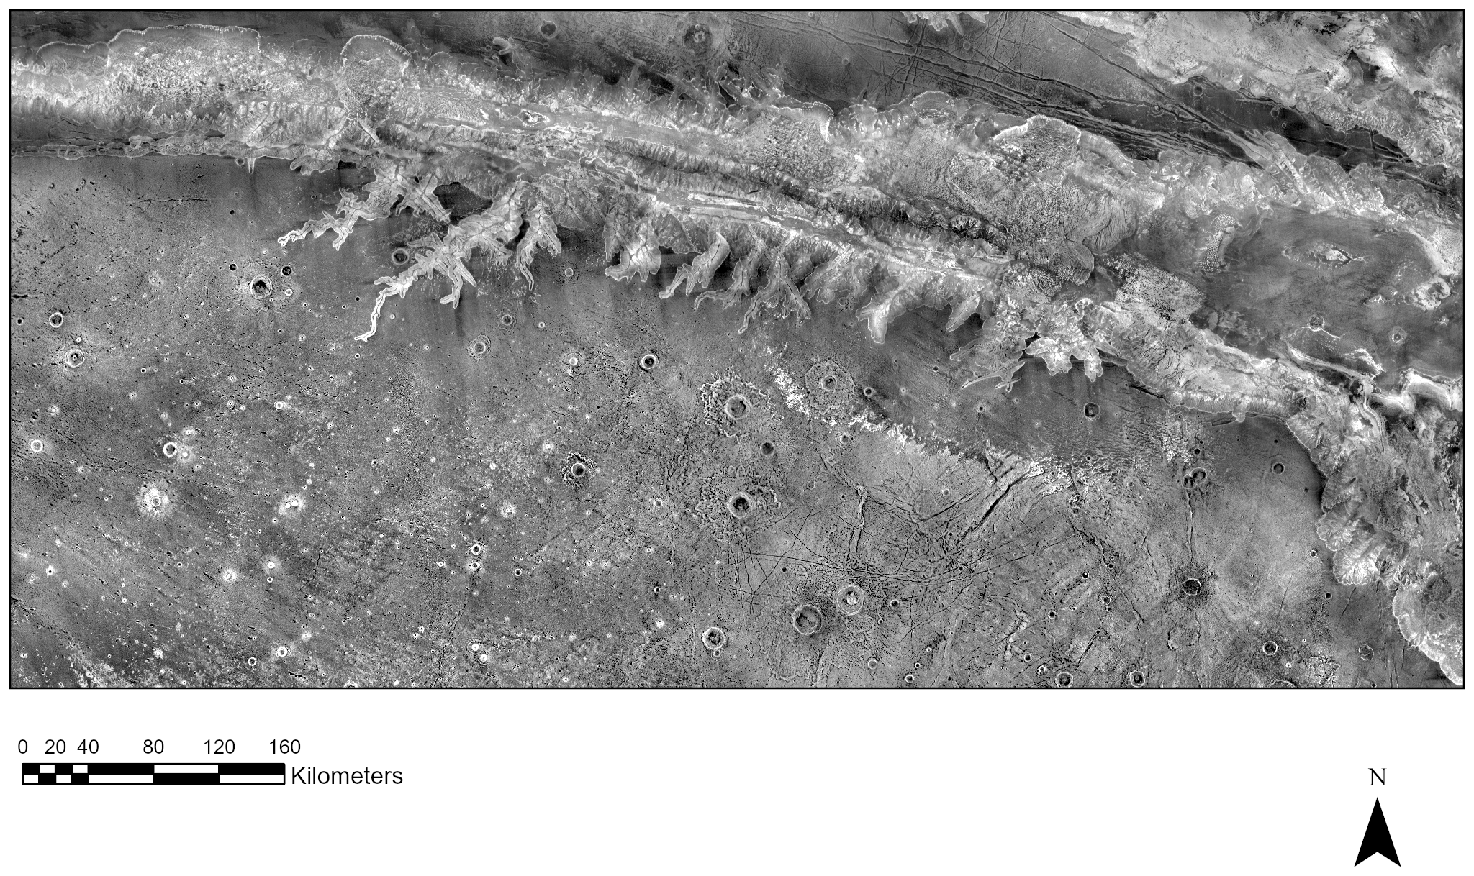
Ius Chasma type area: visible and night IR
271–286°E, 6–13°S: canyon walls, plateau, Louros Valles
Same 100 m grid, every pixel valid in all five bands
Night IR correlates |r| ≤ 0.12 with every other band: information no other layer holds
PROJECT-KNOWLEDGE.md §14.3, §18

Slide 10
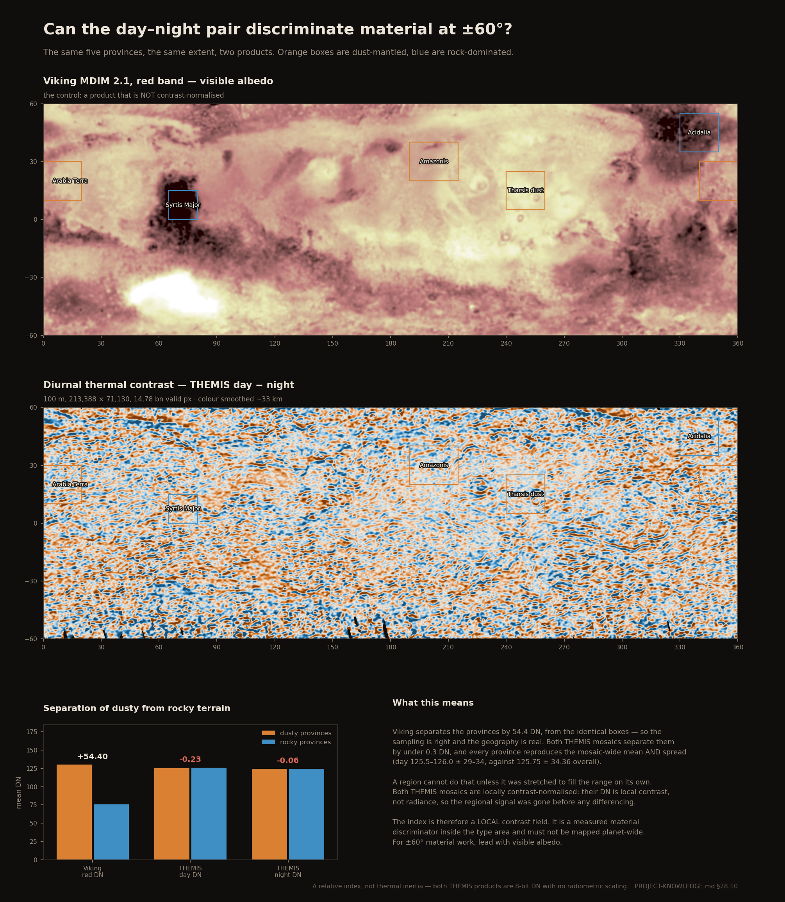
Can the thermal pair map material across ±60°?
Viking separates dusty from rocky provinces by 54.4 DN (these five boxes)
Both THEMIS mosaics separate them by under 0.3 DN
They are contrast-stretched region by region: thermal contrast is local
Planet-wide, visible albedo carries the material signal
PROJECT-KNOWLEDGE.md §28.10

Slide 11
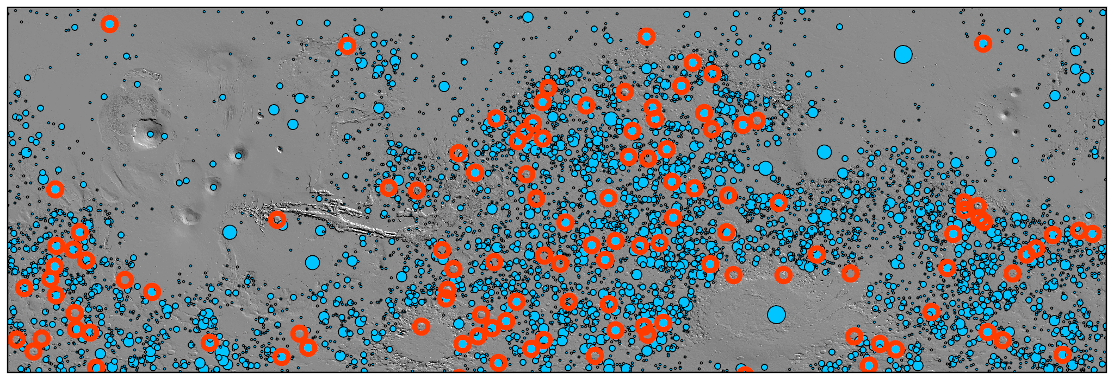
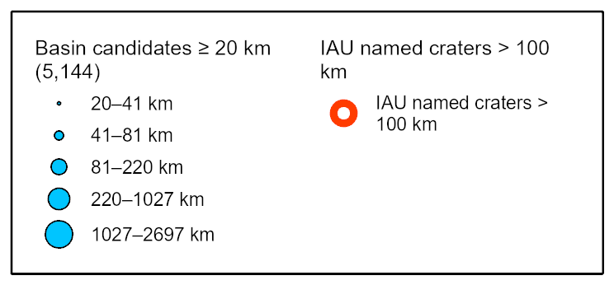
Craters at ±60°: closed depressions ≥ 20 km
5,144 basins found by fill depth in 48 s
68% of 117 IAU craters ≥ 100 km recovered, diameter within ±50%
Diameter error median +2.2%
Misses breached craters by construction: they are not closed
PROJECT-KNOWLEDGE.md §28.11

Slide 12
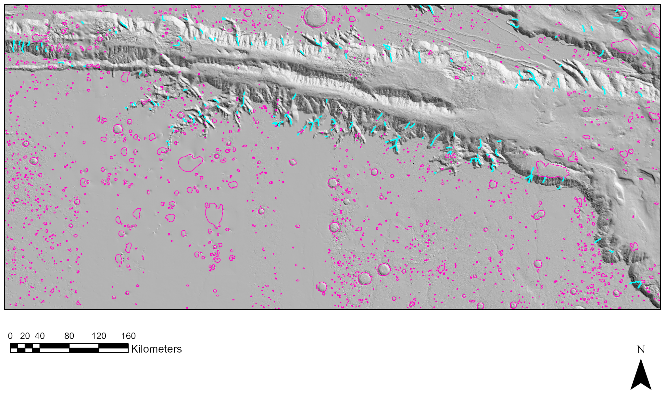
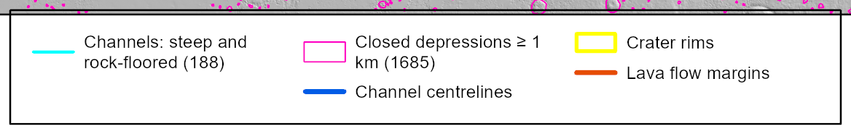
Ius Chasma: candidates to digitise
Fill raised the canyon floor 2,077 m; 56% of the first channel network was artefact
188 channel candidates are steep and rock-floored: the place to start
1,685 closed depressions ≥ 1 km: only 11% match a catalogued (Robbins) crater, so they are prompts, not a crater count
PROJECT-KNOWLEDGE.md §25, §26, §42.3

Slide 13
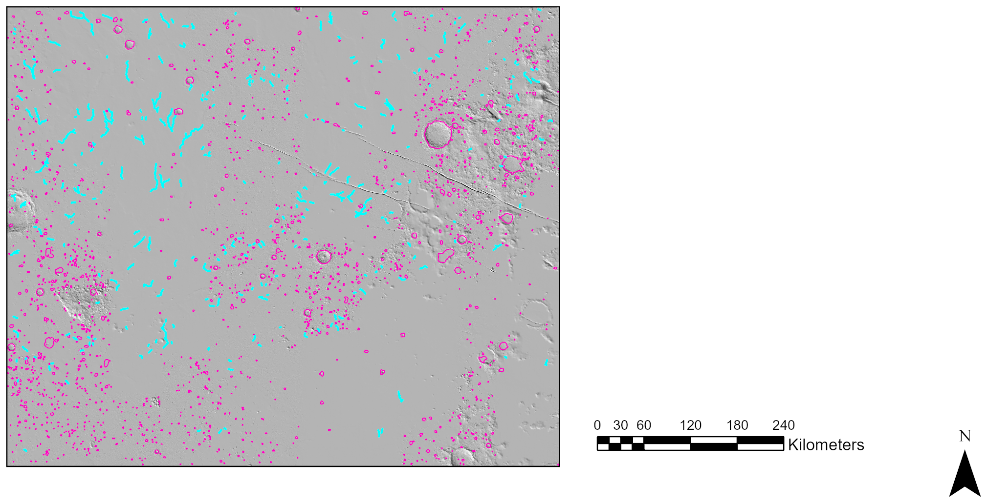
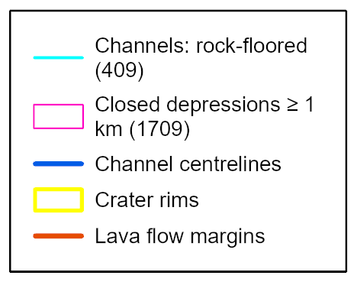
Athabasca Valles: the second type area
Flood lava once mapped as a water channel; the USGS map calls it Late Amazonian volcanic (lAv)
Same 100 m stack, terrain and candidates as Ius: 3,283 channels, 409 rock-floored
Catalogued craters: 1,122 per million km² on lAv, against 1,760 and 2,183 on the older units
Calibrated TES inertia: the diurnal-contrast index does not track it (r ≈ 0); Viking albedo does (−0.55)
PROJECT-KNOWLEDGE.md §41, §42

Slide 14
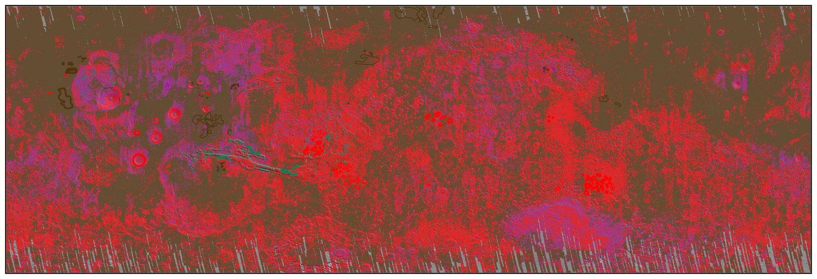
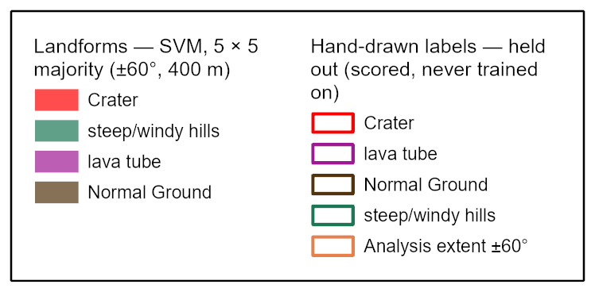
Landforms at ±60°, scored on labels the model never saw
SVM on 512 hand-drawn polygons, split by whole 15° blocks
73.5%, κ 0.58 held out (one class everywhere: 58.6%)
Normal Ground and cratered terrain are solid; lava tube is not (2% user's)
PROJECT-KNOWLEDGE.md §31.3, §32.2

Slide 15
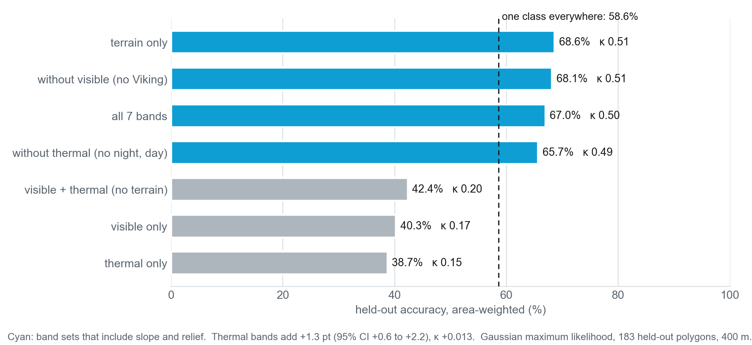
Does thermal infrared improve the classification?
Slope and relief alone: 68.6%, κ 0.52 held out; all seven bands: 67.0%, κ 0.50
The thermal bands add +1.3 points (95% interval +0.6 to +2.2): real, but small
Without terrain, visible and thermal score below one class everywhere (58.6%)
The labelled classes are landforms, so terrain decides them; the thermal claim needs material labels
PROJECT-KNOWLEDGE.md §40

Slide 16
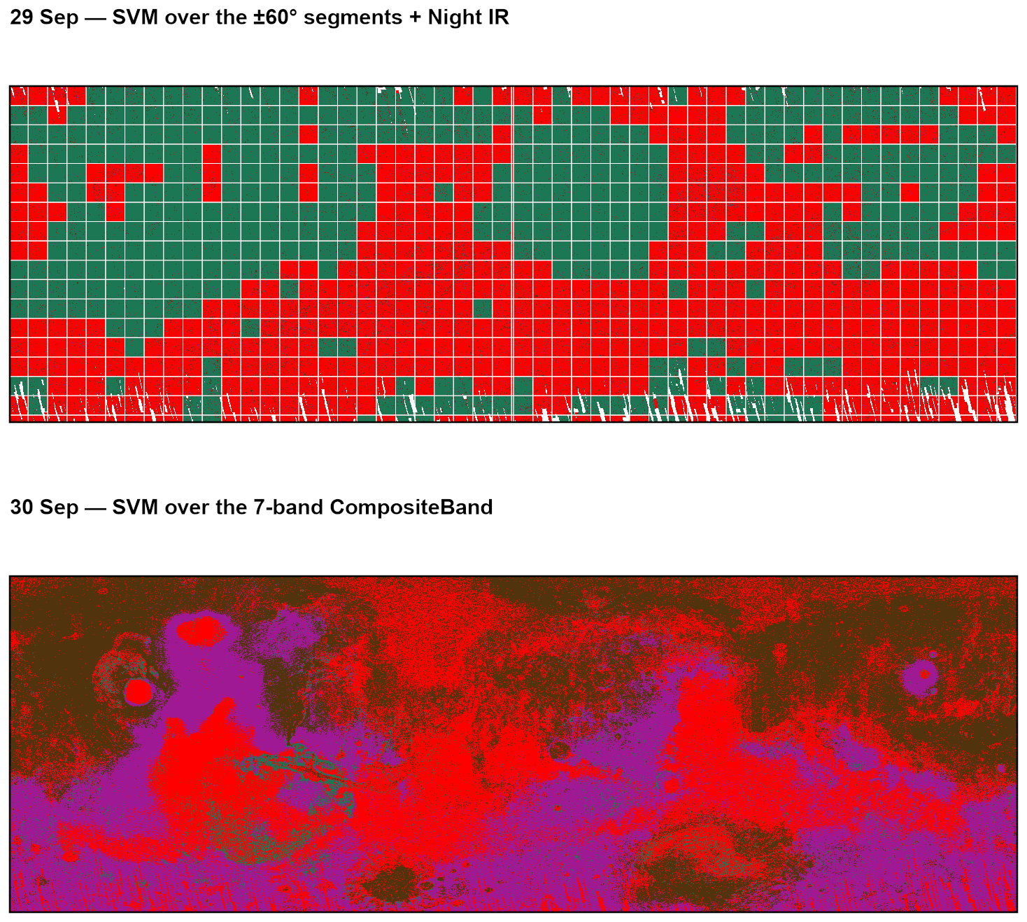
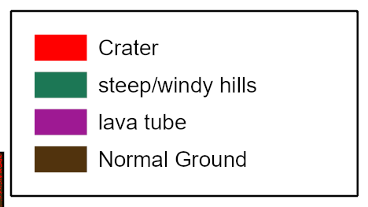
Checking the first two classifications
29 Sep map follows its 4096-px processing tiles, not the terrain
30 Sep map is mostly elevation: elevation alone reproduces 62% of it
Both led to the corrected stack: no elevation band, slope in degrees
PROJECT-KNOWLEDGE.md §30

Slide 17
Project Issues and Hurdles
Thermal contrast is local — Both THEMIS mosaics were stretched region by region, so day–night contrast works inside one area and fails across the planet. Calibrated thermal inertia is not derivable from them (§24, §28.10).
Lava flows have no reliable product yet — The lava tube class is right 2% of the times it is mapped. Needs new labels or the USGS geologic map.
Digitising has not started — The three landform classes are ready and empty; it is the critical path, and only judgement can do it.
Closed-depression craters only — Fill depth finds closed basins; breached craters, the fluvially modified ones, need hand mapping (§26.3).
250 GB on one USB drive — Reads cap near 112 MB/s, and the drive has dropped off mid-write; big outputs are built on internal disk first (§2.2, §36.4).
Solved since September — Three coordinate frames, the z-factor defect, four failed global composites, the missing night mosaic (§15, §18, §20).

Slide 18
Next Steps
Digitise Ius Chasma: accept or reject the machine candidates, then draw what they miss
Measure whether the thermal bands improve the classification, with the hand-drawn labels
Craters and channels ≥ 1 km across ±60° (a 7-hour resumable run)
A second type area at Athabasca Valles: flood lava once mapped as a water channel
Score against the USGS geologic map: the reference for lava flows
When | What
8–25 Oct | Digitising starts; thermal test; ±60° crater and channel run; Athabasca
26 Oct – 1 Nov | ±60° crater and channel sheets; reference data scored
mid-Nov | Interim presentation and report
14–22 Nov | Validation against the digitised landforms; lava-flow sheet; data freeze
23 Nov – 4 Dec | Final report and presentation
8 Dec | Final due

